Slide 1

Furniture Sales Forecasting
Abdulaziz Alshehri

Slide 2
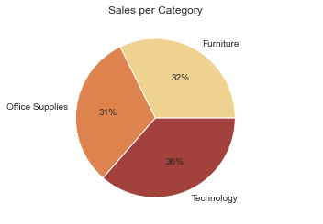
Our Furniture Sales

Slide 3
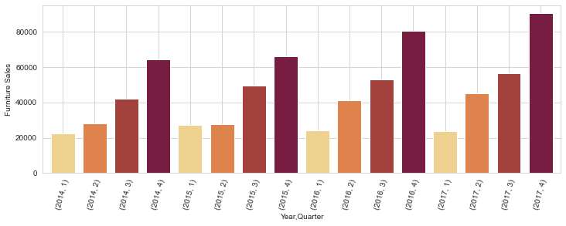
Furniture Sales per Quarter

Slide 4
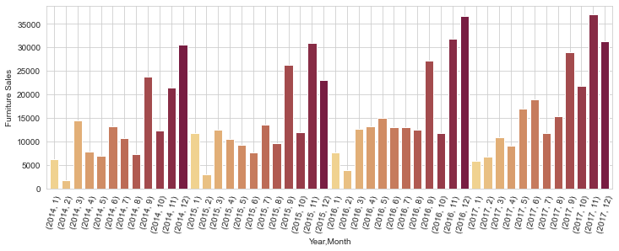
Furniture Sales per Month

Slide 5
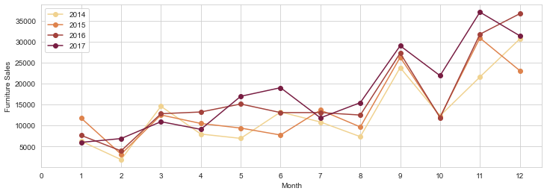
Furniture Sales Comparison

Slide 6
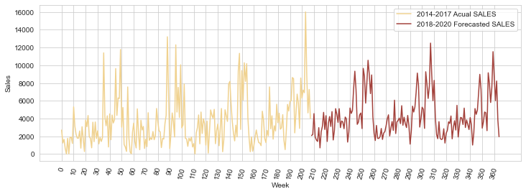
What Sales in years look like?
Similar to the last 4 years.
We will have relatively low sales in the beginning of each year and relatively high sales in the months 9, 11 and 12.

